Slide 1
M.Tech. (AIML) Session-5 (Random Variables)
Team ISM

Slide 2
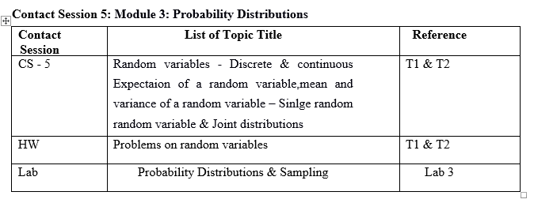
Session-5 Agenda
Random variables –
Discrete & continuous Expectation of a random variable,
mean and variance of a random variable –
Single random random variable &
Joint distributions

Slide 3
Random Variables
A random variable is a variable that assumes numerical values associated with the random outcome of an experiment, where one (and only one) numerical value is assigned to each sample point.
In mathematical language, a random variable is a function whose domain is the sample space and whose range is the set of real numbers.

Slide 4
Random Variables
A random variable can be classified as being either discrete or continuous depending on the numerical values it assumes.
A discrete random variable may assume either finite or countably infinite number of values
A continuous random variable may assume any numerical value in an interval or collection of intervals.
Continuous random variables are generated in experiments where things are “measured’ as opposed to “counted”.
Experimental outcomes based on measurement of time, distance, weight, volume etc. generate continuous RV.

Slide 5
Types of random Variables
A discrete random variable can assume a countable number of values.
Number of steps to the top of the Eiffel Tower*
A continuous random variable can assume any value along a given interval of a number line.
The time a tourist stays at the top once s/he gets there

Slide 6


Two Types of Random Variables
Discrete random variables
Number of sales
Number of calls
Shares of stock
People in line
Mistakes per page
Continuous random variables
Length
Depth
Volume
Time
Weight

Slide 7
Discrete Probability Distributions
The probability distribution for a random variable describes how probabilities are distributed over the values of the random variable.
The probability distribution is defined by a probability function, denoted by f(x), which provides the probability for each value of the random variable.
The required conditions for a discrete probability function are:
f(x) > 0
Σf(x) = 1
We can describe a discrete probability distribution with a table, graph, or equation.
Advantage: once the probability distribution is known, it is relatively easy to determine the probability of a variety of events that may be of interest to the decision maker.

Slide 8
Probability Distributions for Discrete Random Variables
x | P(x)
1 | .30
2 | .21
3 | .15
4 | .11
5 | .07
6 | .05
7 | .04
8 | .02
9 | .02
10 | .01
Say a random variable x follows this pattern: p(x) = (.3)(.7)^{x-1} for x >0.
This table gives the probabilities (rounded to two digits) for x between 1 and 10.

Slide 9
Expected Value and Variance
The expected value, or mean, of a random variable is a measure of its central location.
The mean or Expected value of a discrete random variable:
E(x) = μ = Σxf(x)
The variance summarizes the variability in the values of a random variable.
Variance of a discrete random variable:
Var(x) = σ ² = Σ(x - μ)²f(x)
The standard deviation, σ, is defined as the positive square root of the variance.

Slide 10
Rules of Expected Value
Multiplying RV by a constant a, E(aX) = a.E(X)
Adding a constant b, E(X+b) = E(X) + b
Therefore, E(aX + b) = ?

Slide 11
Variability of Discrete Random Variables
The variance of a discrete random variable x is
The standard deviation of a discrete random variable x is

Slide 12

Rules of variability
Multiplying RV by a constant a, V(aX) = a² . V(X)
Adding a constant b, V(X+b) = V(X)

Slide 13
Example:
At a shooting range, a shooter is able to hit a target in either 1, 2
or 3 shots. Let x be a random variable indicating the number of
shots fired to hit the target. The following probability function
was proposed.
f(x) = x/6
Is this probability function valid?
Identify the r.v to be discrete or continuous?
EXPERIMENT | Random Variable (x)
Audit 50 tax returns | Number of returns that contains error
Operate a restaurant for one day | Number of customers
Observe an employee’s work | No. of productive hours in an 8-hour workday

Slide 14
Example: JSL Appliances
Discrete random variable with a finite number of values
Let x = number of TV sets sold at the store in one day
where x can take on 5 values (0, 1, 2, 3, 4)
Discrete random variable with an infinite sequence of values
Let x = number of customers arriving in one day
where x can take on the values 0, 1, 2, . . .
We can count the customers arriving, but there is no finite upper limit on the number that might arrive.

Slide 15
Example : JSL Appliances
Using past data on TV sales (below left), a tabular representation of the probability distribution for TV sales (below right) was developed.

Slide 16
Example: JSL Appliances
Graphical Representation of the Probability Distribution
.50
.40
Probability
.30
.20
.10
0 1 2 3 4
Values of Random Variable x (TV sales)

Slide 17
Example: JSL Appliances
Expected Value of a Discrete Random Variable
The expected number of TV sets sold in a day is 1.2

Slide 18
Example: JSL Appliances
Variance and Standard Deviation of a Discrete Random Variable
x x - μ (x - μ)² f(x) (x - μ)²f(x)
0 -1.2 1.44 .40 .576
1 -0.2 0.04 .25 .010
2 0.8 0.64 .20 .128
3 1.8 3.24 .05 .162
4 2.8 7.84 .10 .784
1.660 = σ ²
The variance of daily sales is 1.66 TV sets squared.
The standard deviation of sales is 1.2884 TV sets.

Slide 19
Discrete Uniform Probability Distribution
The discrete uniform probability distribution is the simplest example of a discrete probability distribution given by a formula.
The discrete uniform probability function is
f(x) = 1/n
where:
n = the number of values the random variable may assume
Note that the values of the random variable are equally likely.

Slide 24
Continuous Probability Distributions
A continuous random variable can assume any value in an interval on the real line or in a collection of intervals.
It is not possible to talk about the probability of the random variable assuming a particular value.
Instead, we talk about the probability of the random variable assuming a value within a given interval.
The probability of the random variable assuming a value within some given interval from x₁ to x₂ is defined to be the area under the graph of the probability density function between x₁ and x₂.

Slide 25
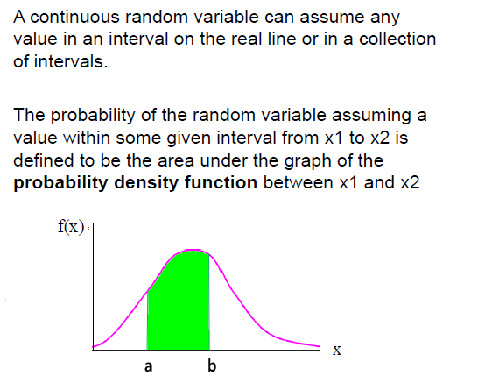
Continuous Random Variables
Example:
Height of students in a class
Amount of ice tea in a glass
Change in temperature throughout a day
Price of a car in next year

Slide 26
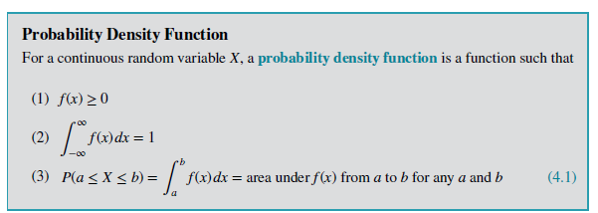
Continuous Random Variables

Slide 27
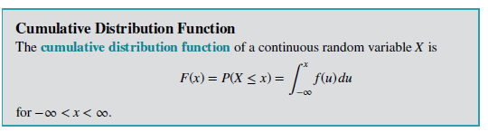
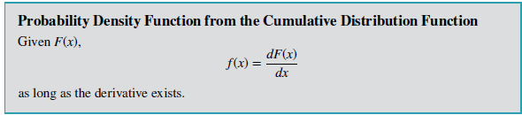
Continuous Random Variables

Slide 28
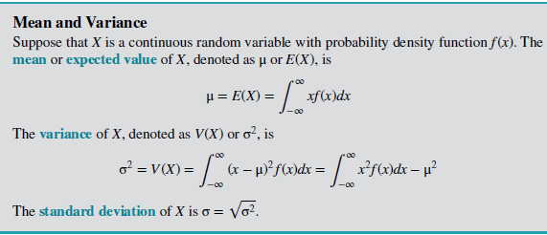
Continuous Random Variables

Slide 29
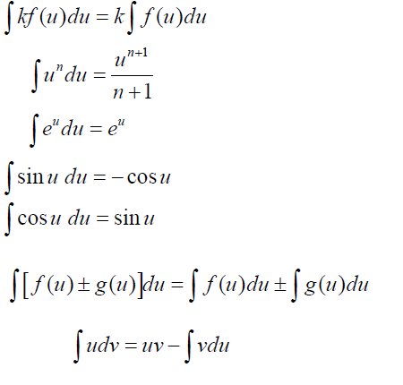
Integration Formulas

Slide 30
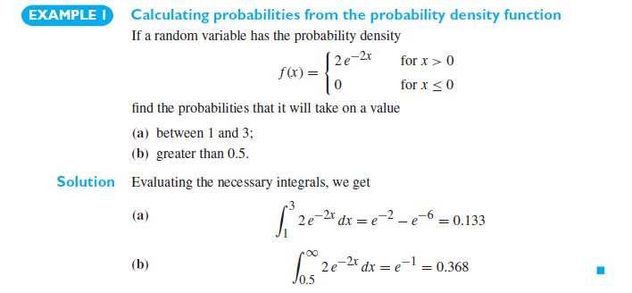
Continuous Random Variables

Slide 31
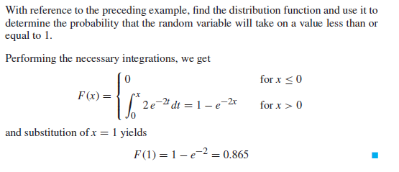

Slide 32
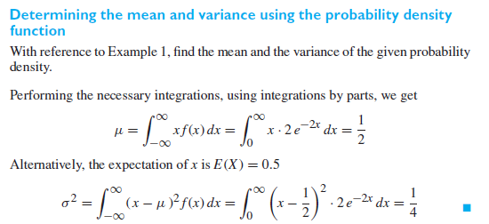

Slide 33
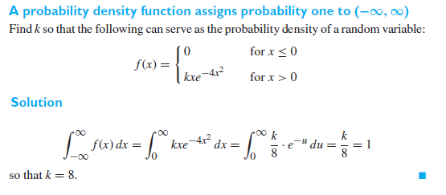

Slide 34
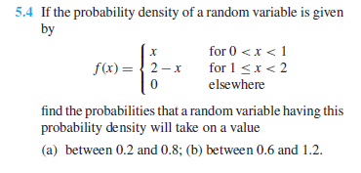
Continuous Random Variables

Slide 35
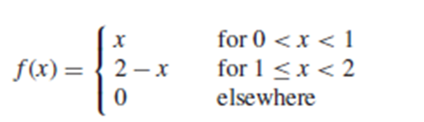
Continuous Random Variables

Slide 36
Continuous Random Variables

Slide 37
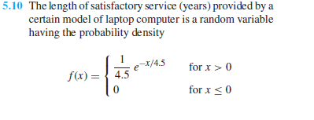
Continuous Random Variables

Slide 38
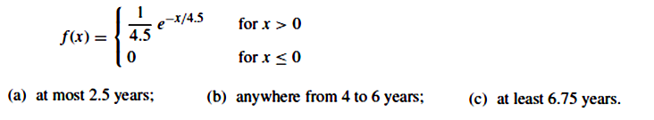
Continuous Random Variables

Slide 39
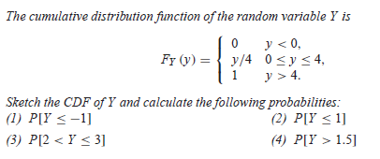
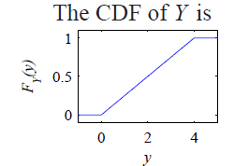
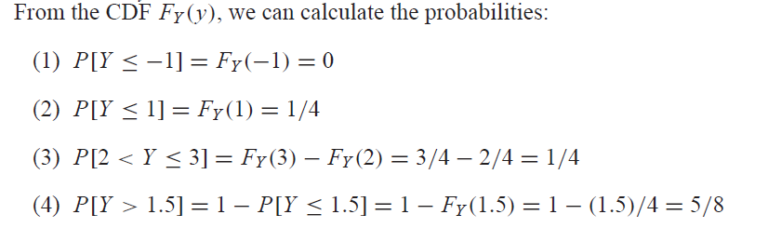

Slide 40
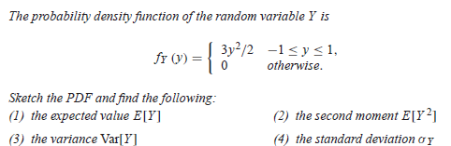

Slide 41
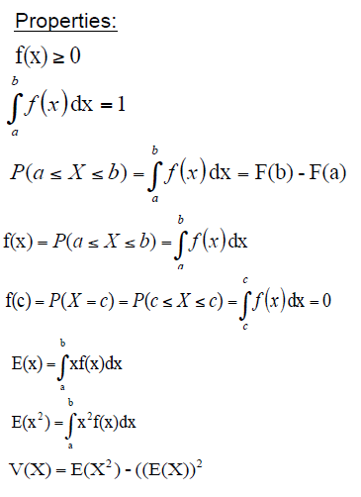
Recall - Continuous Random Variables

Slide 42
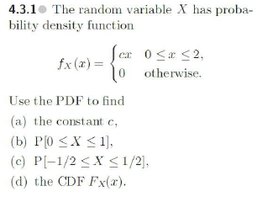
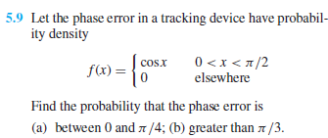
Exercise - Continuous Random Variables

Slide 43

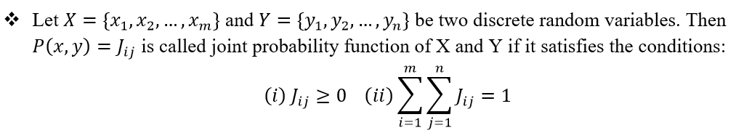
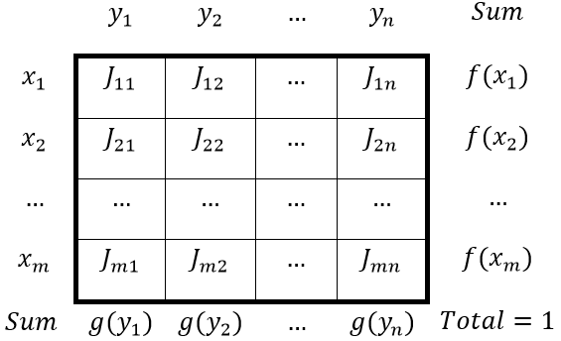
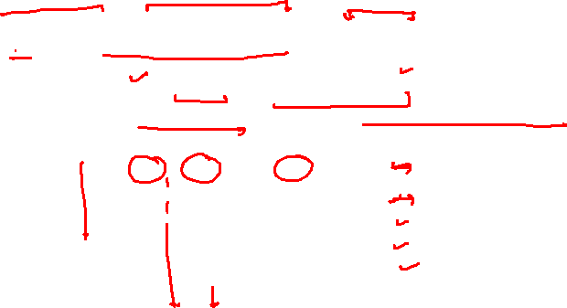

Slide 44
So far we have been talking about the probability of a single variable, or a variable conditional on another.
We often want to determine the joint probability of two variables, such as X and Y. Suppose we are able to determine the following information for education (X) and age (Y) for all Indian citizens based on the census.
Age (Y): Education (X) | Age : 25-35 30 | Age: 35-55 45 | Age: 55-85 70
None 0 | .01 | .02 | .05
Primary 1 | .03 | .06 | .10
Secondary 2 | .18 | .21 | .15
College 3 | .07 | .08 | .04

Slide 45
Each cell is the relative frequency (f/N).
We can define the joint probability distribution as:
p(x, y)= Pr(X = x and Y = y)
Age (Y): Education (X) | Age : 25-35 30 | Age: 35-55 45 | Age: 55-85 70
None 0 | .01 | .02 | .05
Primary 1 | .03 | .06 | .10
Secondary 2 | .18 | .21 | .15
College 3 | .07 | .08 | .04
Example: what is the probability
of getting a 30 year old college
graduate?
p(x,y) = Pr(X=3 and Y=30) = .07
We can see that: p(x) = Σ_{y} p(x,y)
p(x=1) = .03 + .06 + .10 = .19

Slide 46
Marginal Probability
We call this the marginal probability because it is calculated by summing across rows or columns and is thus reported in the margins of the table.
We can calculate this
for our entire table.
Age (Y): Education (X) | 30 | 45 | 70 | p(x)
None: 0 | .01 | .02 | .05 | .08
Primary: 1 | .03 | .06 | .10 | .19
Secondary: 2 | .18 | .21 | .15 | .54
College: 3 | .07 | .08 | .04 | .19
p(y) | .29 | .37 | .34 | 1

Slide 47
If X and Y are discrete random variables, the joint probability distribution of X and Y is a description of the set of points (x,y) in the range of (X,Y) along with the probability of each point.
The joint probability distribution of two discrete random variables is sometimes referred to as the bivariate probability distribution or bivariate distribution.
Thus we can describe the joint probability distribution of two discrete random variables is through a joint probability mass function
f(x,y)=P(X=x,Y=y)

Slide 48
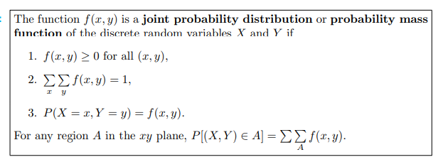
Joint Probability Mass Function

Slide 49

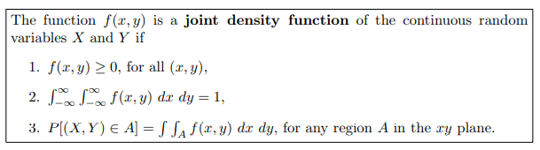
Joint Density Function

Slide 50
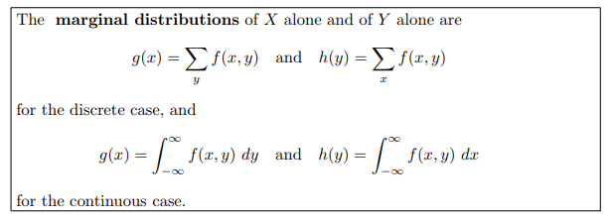
Marginal Distributions

Slide 51




Solution:

Slide 52





Cont.

Slide 53
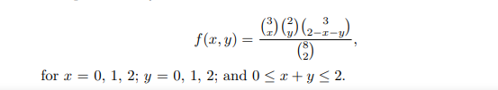
Problem:
Two ballpoint pens are selected at random form a box that contains blue pens, 2 red pens and 3 green pens. If X is the number of blue pens selected and Y is the number of red pens selected, find the joint probability function f(x,y)
Solution:
The possible pairs of values (x,y) are (0,0),(0,1),(1,0),(1,1),(0,2),(2,0)
The joint probability distribution can be represented by the formula

Slide 54
Joint distribution
f(x,y) |  | X |  |  | Rows Total
 |  | 0 | 1 | 2
y | 0 | 3/28 | 9/28 | 3/28 | 15/28
 | 1 | 3/14 | 3/14 | 0 | 3/7
 | 2 | 1/28 | 0 | 0 | 1/28
Columns Total |  | 5/14 | 15/28 | 3/28 | 1

Slide 55
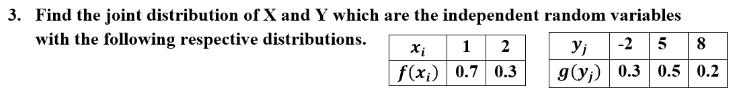


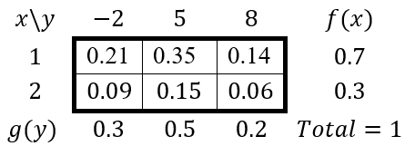
Solution:

Slide 56
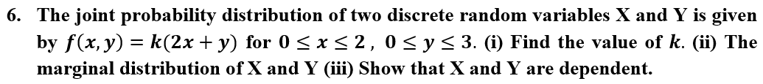

Slide 57
Q.9 A candy company distributed boxes of chocolates with a mixture of creams, toffees, and nuts coated in both light and dark chocolate. For a randomly selected box, let X and Y, respectively, be the proportions of the light and dark chocolates that are creams and suppose that the joint density function is
a) Verify whether
b) Find P[(X,Y) ∈ A], where A is the region {(x,y) | 0<x<½,¼<y<½}
c) Find g(x) and h(y) for the joint density function.

Slide 58
Example 9 – Solution
a)

Slide 59
Example – Solution
b)

Slide 60
Example – Solution
By definition,
For 0≤x ≤1, and g(x)=0 elsewhere.
Similarly,
For 0 ≤y ≤1, and h(y)=0 elsewhere.

Slide 61
Problem:
Find ‘K’ if the joint probability density function of a bivariate random variable (X,Y) is given by

Slide 62
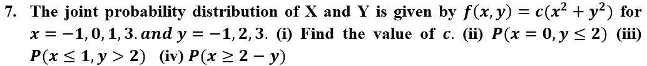




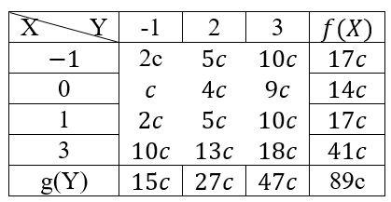







Solution:

Slide 63

Cont.

Slide 64
Thank You !

